Slide 1

Database Systems:
Design, Implementation, and Management
Chapter 2
Data Models

Slide 2
Introduction
Designers, programmers, and end users see data in different ways
Different views of same data lead to designs that do not reflect organization’s operation
Data modeling reduces complexities of database design
Various degrees of data abstraction (understanding) help reconcile varying views of same data

Slide 3
Data Modeling and Data Models
Data models
  Relatively simple representations of complex real-world data structures
    Often graphical
Model (in general) is an abstraction (representation in model form) of a real-world object or event
  Useful in understanding complexities of the real-world environment
Data modeling is iterative and progressive (Process of Refinement)

Slide 4
The Importance of Data Models
Facilitate interaction among the designer, the applications programmer, and the end user (Reference for discussion, verification, understanding and agreement)
End users have different views and needs for data
Data model organizes data for various users
Data model is an abstraction (A model of our understanding)

Slide 5
Data Model Basic Building Blocks
Entity: anything about which data are to be collected and stored
Attribute: a characteristic of an entity
Relationship: describes an association among entities
  One-to-many (1:M) relationship
  Many-to-many (M:N or M:M) relationship
  One-to-one (1:1) relationship
Constraint: a restriction placed on the data

Slide 6
Business Rules
Descriptions of policies, procedures, or principles within a specific organization
  Apply to any organization that stores and uses data to generate information
Description of operations to create/enforce actions within an organization’s environment
Must be in writing and kept up to date
Must be easy to understand and widely disseminated
Describe characteristics of data as viewed by the company

Slide 7
Examples of Business Rules:
A Customer may generate many Invoices
An Invoice is generated by only one customer
Invoices totaling over $500 are eligible for a 10% discount
A Class may contain a maximum of 20 students

Slide 8
Discovering Business Rules
Sources of business rules:
  Company managers
  Policy makers
  Department managers
  Written documentation
    Procedures
    Standards
    Operations manuals
  Direct interviews with end users

Slide 9
Translating Business Rules into Data Model Components
Generally, nouns translate into entities
Verbs translate into relationships among entities
Relationships are bidirectional
Two questions to identify the relationship type:
  How many instances of B are related to one instance of A?
  How many instances of A are related to one instance of B?

Slide 10
Before the Relation model
The Hierarchical Model
Then
The Network Model
These models had certain disadvantages and these lead to the development of the Relational Model.
More details in text.
Also: Research further on-line, if you are interested in the models that preceded the Relational Model.

Slide 11
The Relational Model
Developed by E. F. Codd (IBM) in 1970
Table (relations)
  Matrix consisting of row/column intersections
  Each row in a relation called a tuple
Relational models considered impractical in 1970 (Computers lacked the power to implement this model)
Model conceptually simple at expense of computer overhead

Slide 12
The Relational Model (continued)
Relational data management system (RDBMS)
  Performs same functions provided by the previous models
  However, it hides the complexities from the user
Relational diagram
  Representation of entities, attributes, and relationships

Slide 13
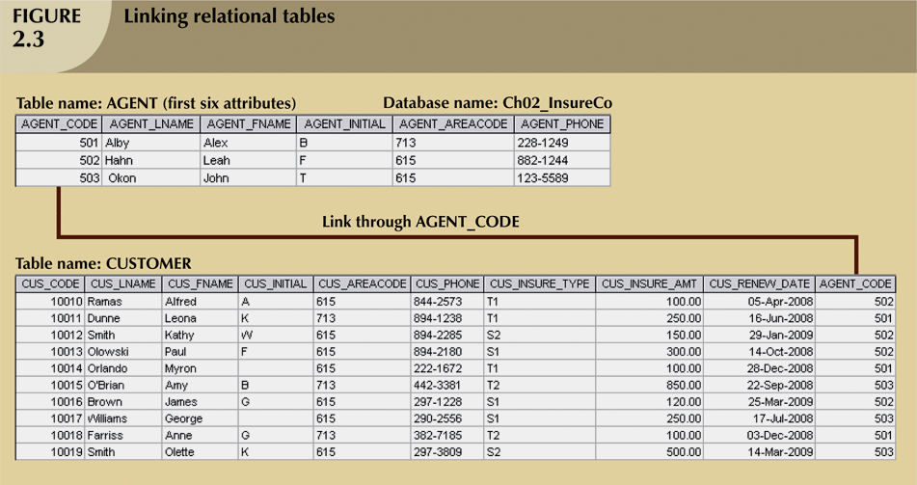

Slide 14
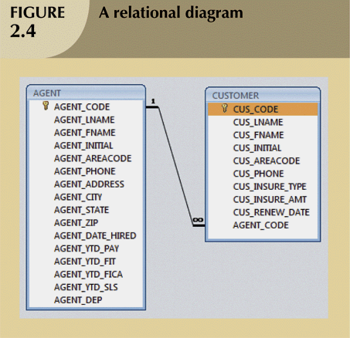

Slide 15
The Relational Model (continued)
SQL-based relational database application involves three parts:
  User interface
    Allows end user to interact with the data
  Set of tables stored in the database
    Each table is independent from another
    Rows in different tables related based on common values in common attributes
  SQL “engine”
    Executes all queries

Slide 16
The Entity Relationship Model
Widely accepted standard for data modeling
Introduced by Chen in 1976
Graphical representation of entities and their relationships in a database structure
Entity relationship diagram (ERD)
  Uses graphic representations to model database components
  Entity is mapped to a relational table

Slide 17
The Entity Relationship Model (continued)
Entity instance (or occurrence) is row in table
Entity set is collection of like entities
Connectivity describes types of relationships
Relationships expressed using Chen notation
  Relationships represented by a diamond
  Relationship name written inside the diamond
Crow’s Foot notation (the more current notation) is used as the design standard in our text

Slide 18
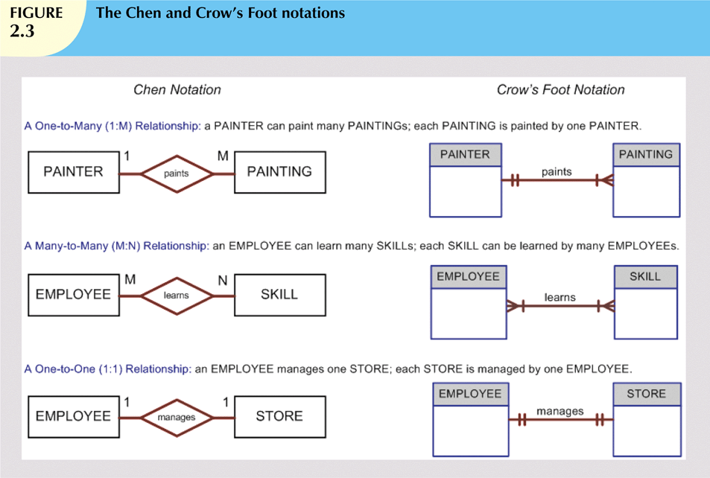

Slide 19
The Object-Oriented (OO) Model
Data and relationships contained in single structure known as an object
OODM (object-oriented data model) is the basis for OODBMS
  Semantic data model
Objects contain operations
Object is self-contained: a basic building-block for autonomous structures
Object is an abstraction of a real-world entity

Slide 20
OO Model Representation with 2 Entities
One Member may make one or more donations
(One to Many Relationship)
MEMBER
M
DONATION
Member Attributes are not shown in this initial representation. As you refine the model and know what the attributes are, you may include them.

Slide 21
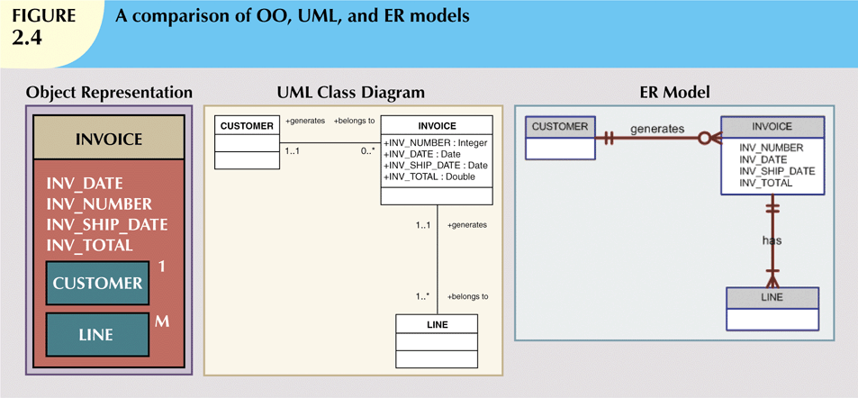
Object Model: The Invoice Object is associated with One (1) Customer and may contain Many (M) lines.
UML Model: An Invoice belongs to one and only 1 customer (1..1) A Customer generates
Zero or more Invoices (0..*) An Invoice generates one or more Lines (1..*) A Line belongs to one
and only 1 Invoice (1..1)

Slide 22
Degrees of Data Abstraction
Database designer starts with abstracted view, then adds details
ANSI Standards Planning and Requirements Committee (SPARC)
  Defined a framework for data modeling based on degrees of data abstraction (1970s):
    External
    Conceptual
    Internal

Slide 23
The External Model
End users’ view of the data environment
Departmental views are initially modeled separately.
Includes:
  Entities
  Relationships
  Processes
  Constraints

Slide 24
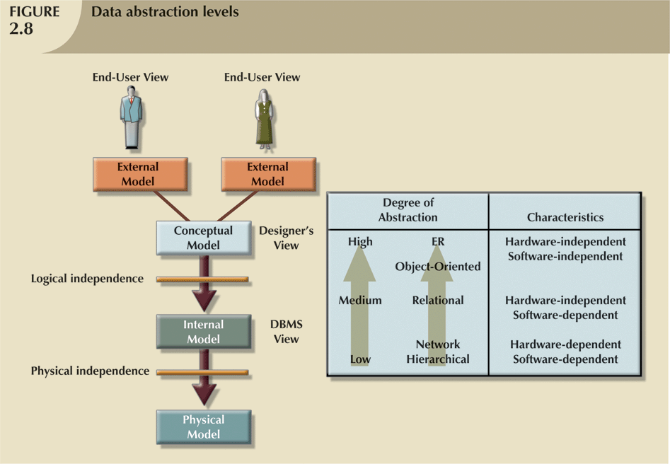

Slide 25
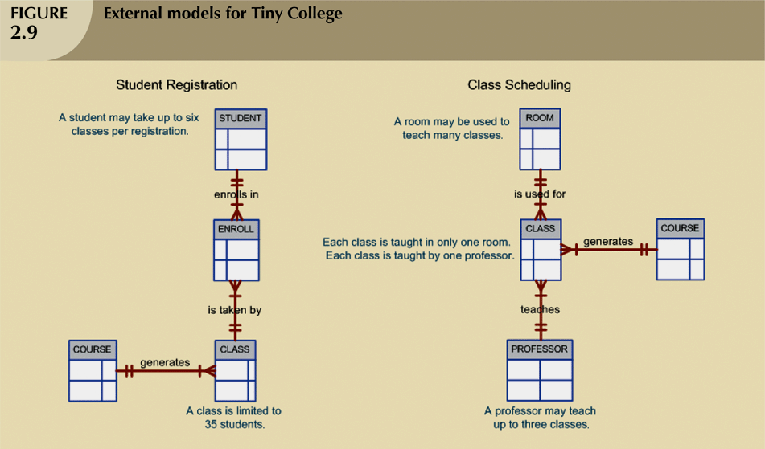

Slide 26
The Conceptual Model
Also know as the Designer’s view
Represents global view of the entire database
All external views integrated into single global view: conceptual schema

Slide 27
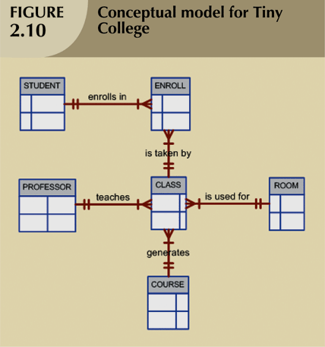

Slide 28
The Conceptual Model (continued)
Provides a relatively easily understood macro level view of data environment
Independent of both software and hardware
  Does not depend on the DBMS software used to implement the model
  Does not depend on the hardware used in the implementation of the model
  Changes in hardware or software do not affect database design at the conceptual level

Slide 29
The Internal Model
Representation of the database as “seen” by the DBMS
  Maps the conceptual model to the DBMS
Internal schema depicts a specific representation of an internal model
Depends on specific database software
  Change in DBMS software requires internal model be changed

Slide 30
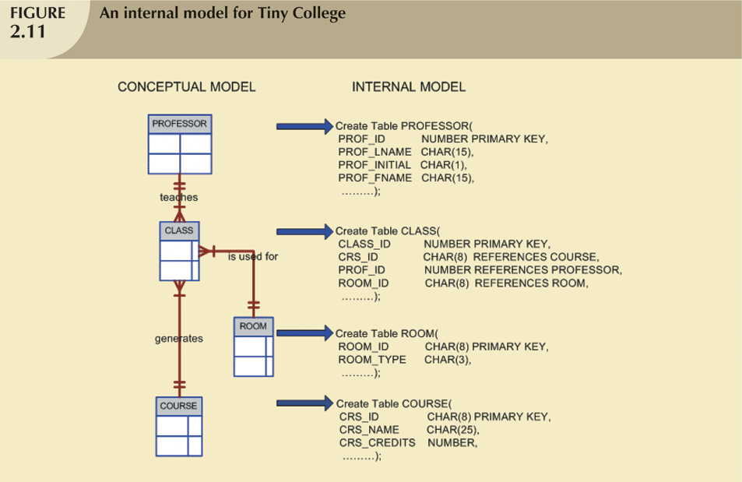

Slide 31
The Physical Model
Operates at lowest level of abstraction
  Describes the way data are saved on storage media such as disks or tapes
Requires the definition of physical storage and data access methods
Relational model aimed at logical level
  Does not require physical-level details

Slide 32
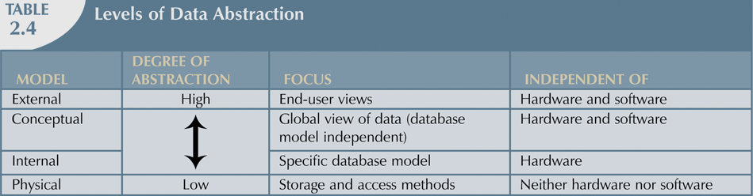

Slide 33
Summary
A data model is an abstraction of a complex real-world data environment
Basic data modeling components:
  Entities
  Attributes
  Relationships
  Constraints
Business rules identify and define basic modeling components

Slide 34
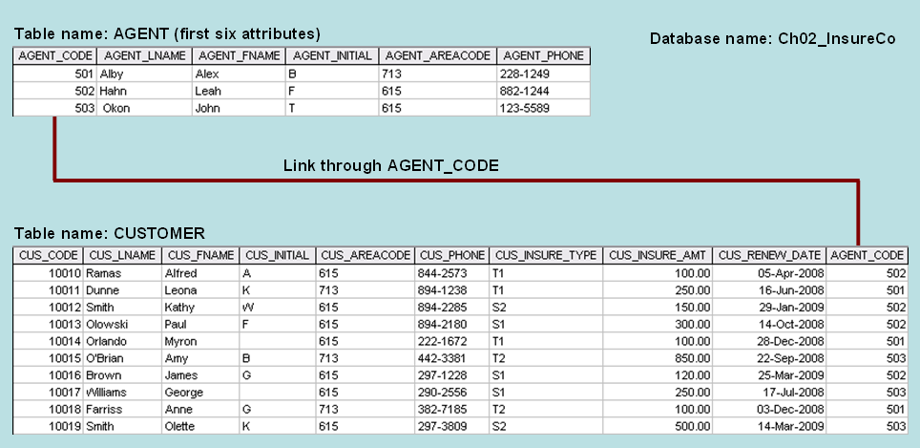
Class Group Exercise (Chapter 2 Page 59 – Problems 1, 2 & 3)
Given the above tables and linkage shown, write the business rule(s) that governs the relationship between AGENT and CUSTOMER.
Given the business rule(s) you wrote in Problem 1, create the basic Crow’s Foot and Chen ERDs.
Using the ERD you drew in Problem 2, create the equivalent Object representation and UML class diagrams. ( 2 separate models )
(Use Figure 2.4 in text as your guide.)

